Slide 1

CLASS 1 SATYAM
CLASS TEACHER
MS. ALPANA GAUTAM

Slide 2

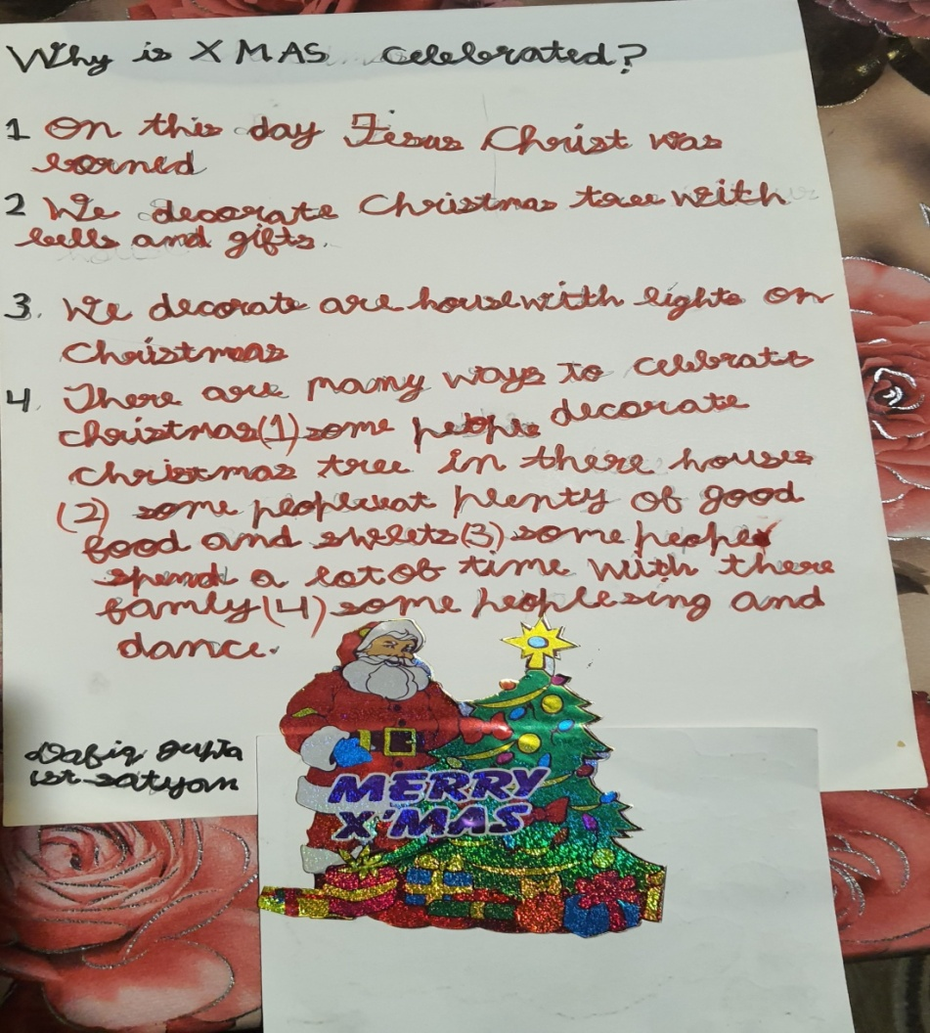
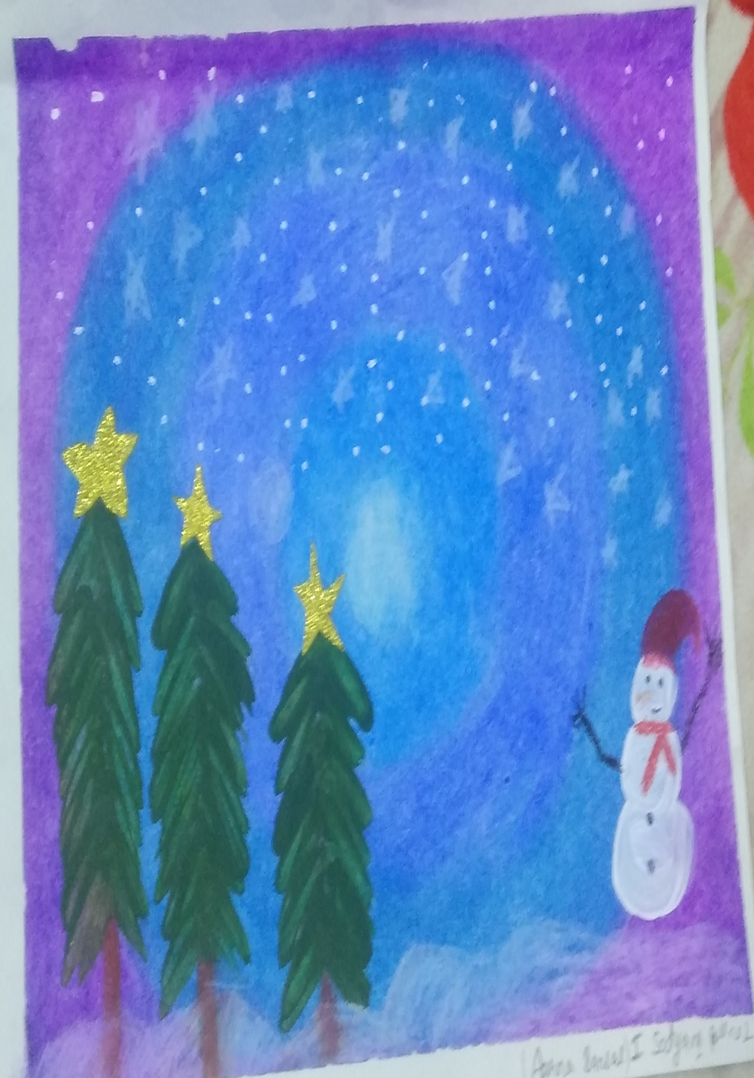
Aarna

Slide 3

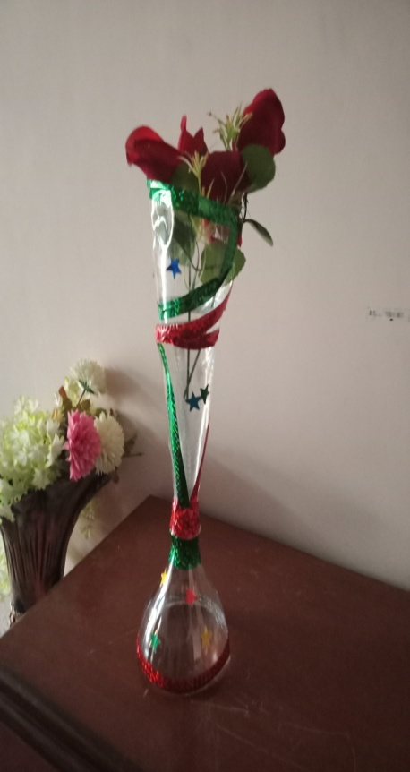
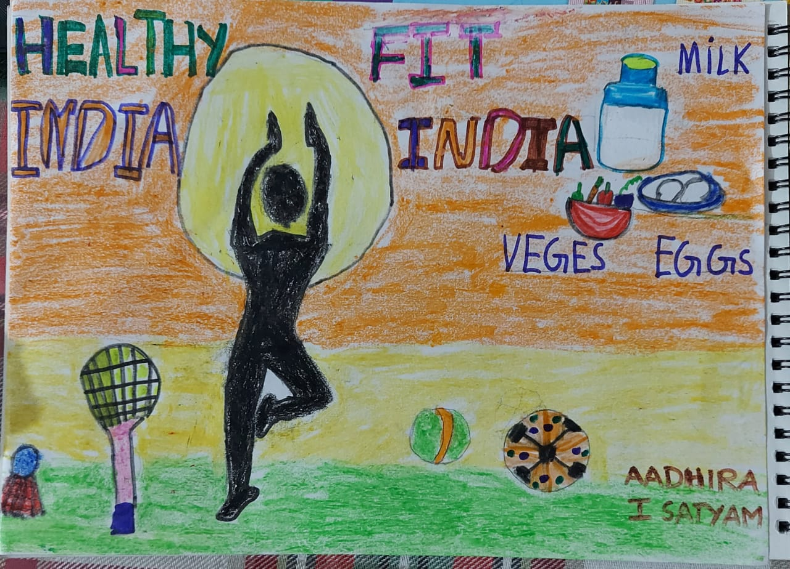
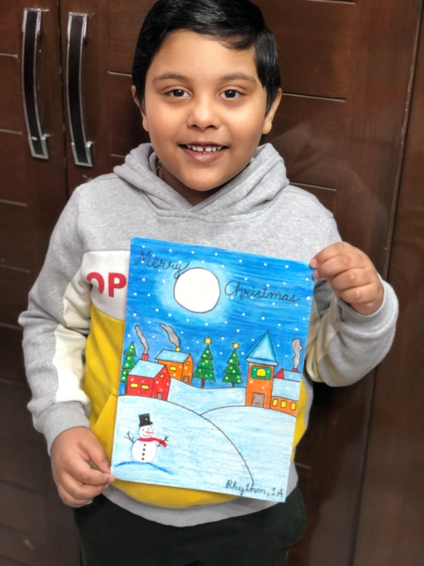
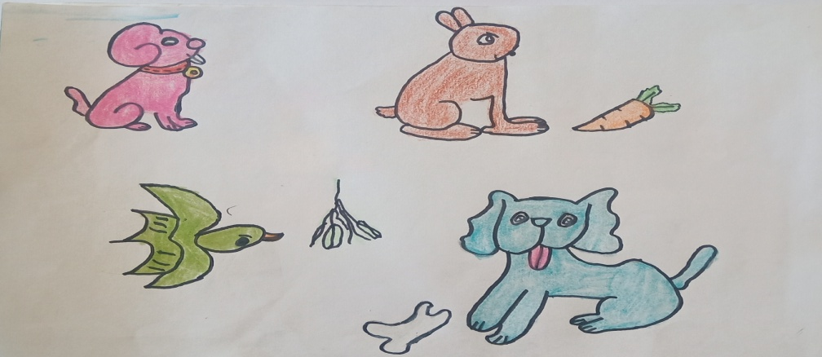
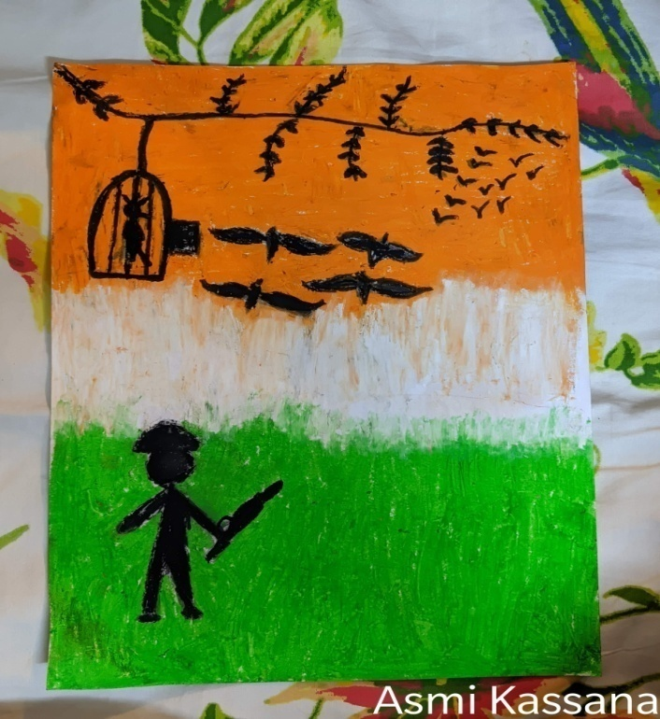
Rhythm
Kaviraj
Veronika

Slide 4
Artists of
Class 1 Shivam
Class TeaCHER- Ms. Kanchan chadha

Slide 5
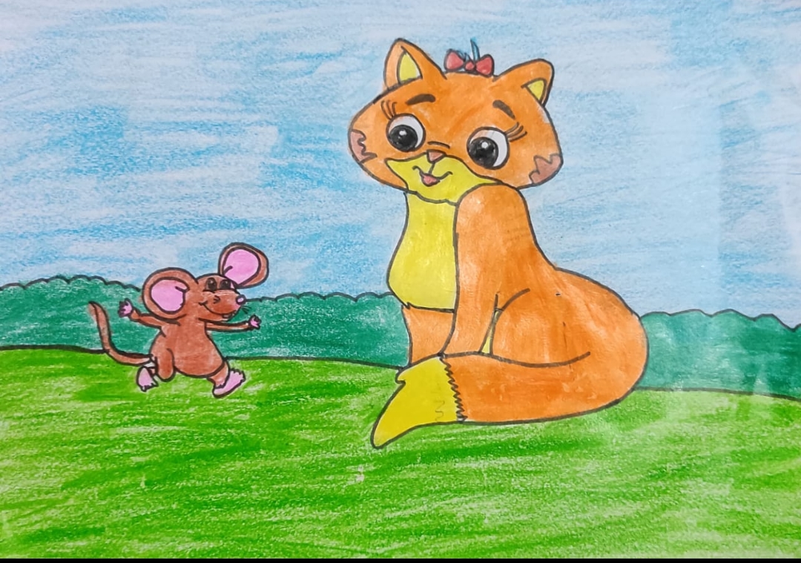
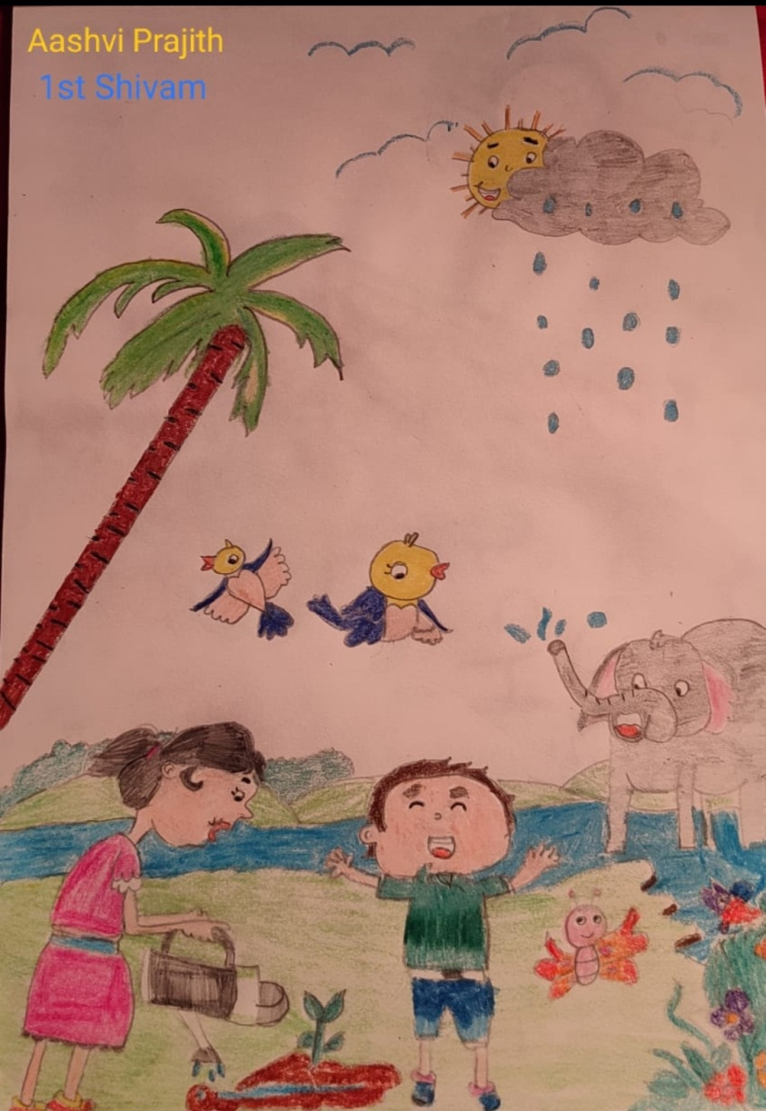
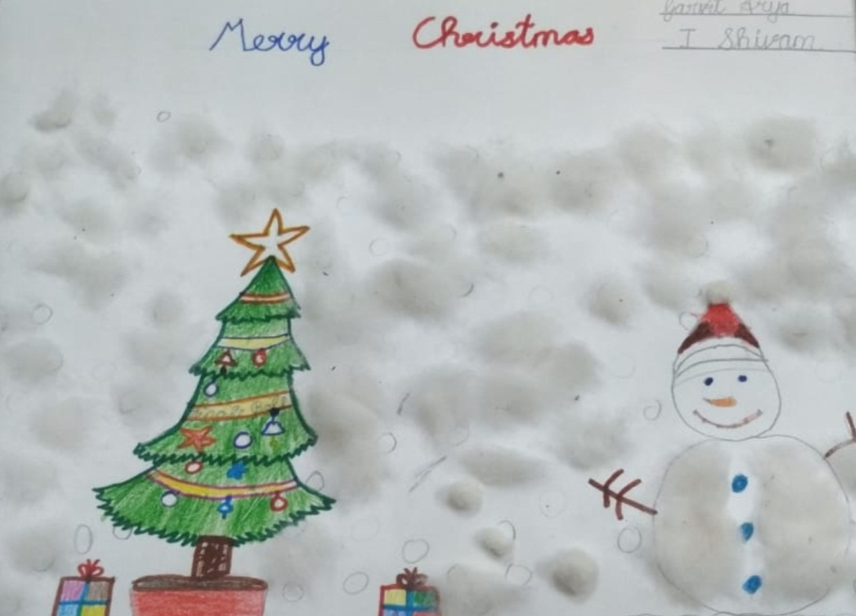
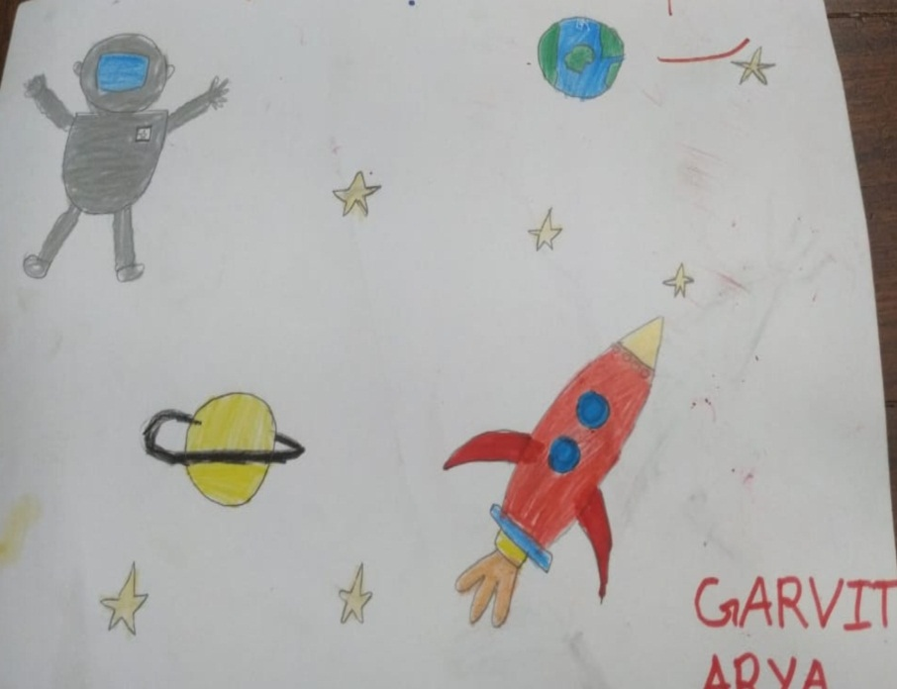
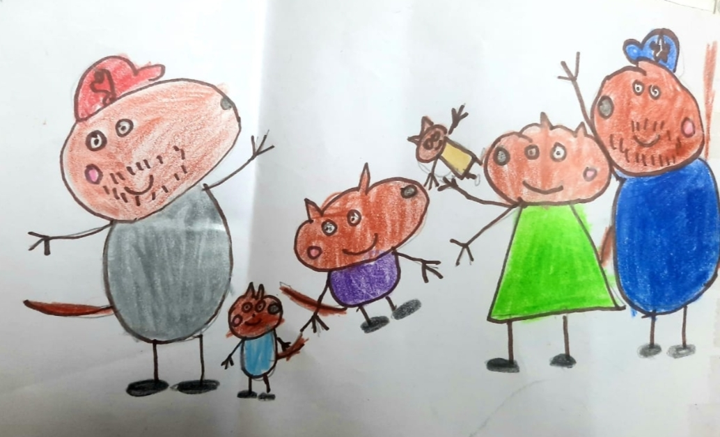
Aadish Singla
Aashvi Prajith
Drawings by Garvit Arya
Peppa pig’s family by Maulik Chopra

Slide 6
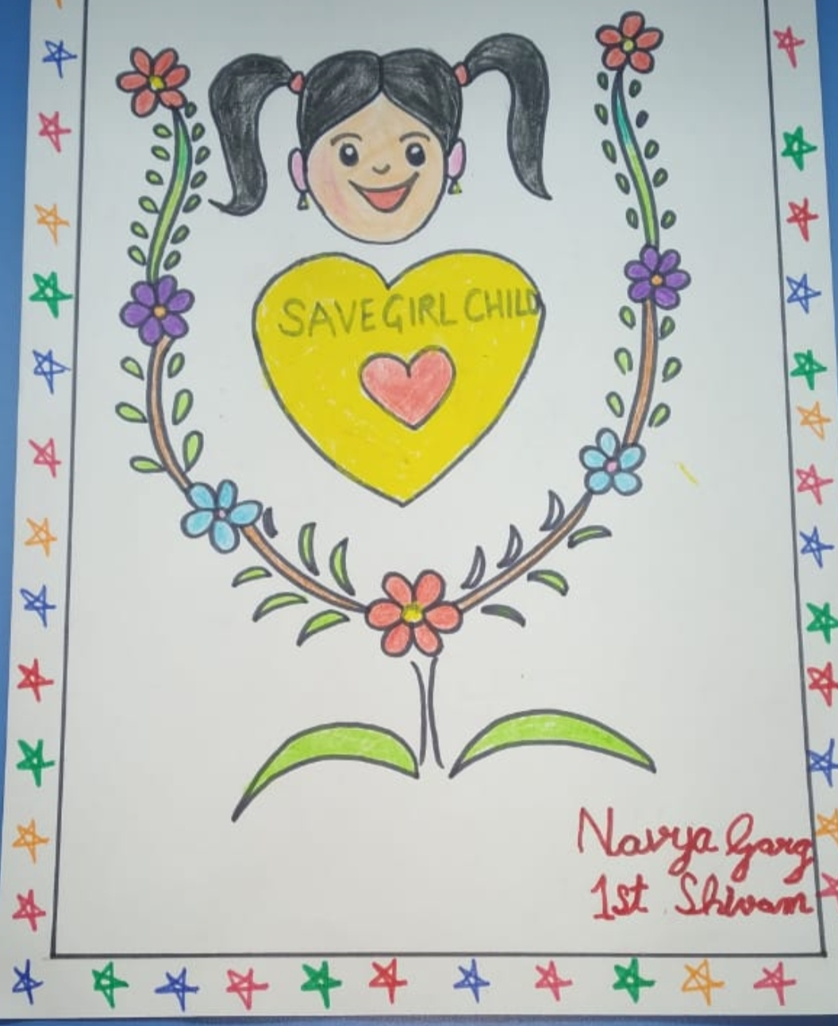
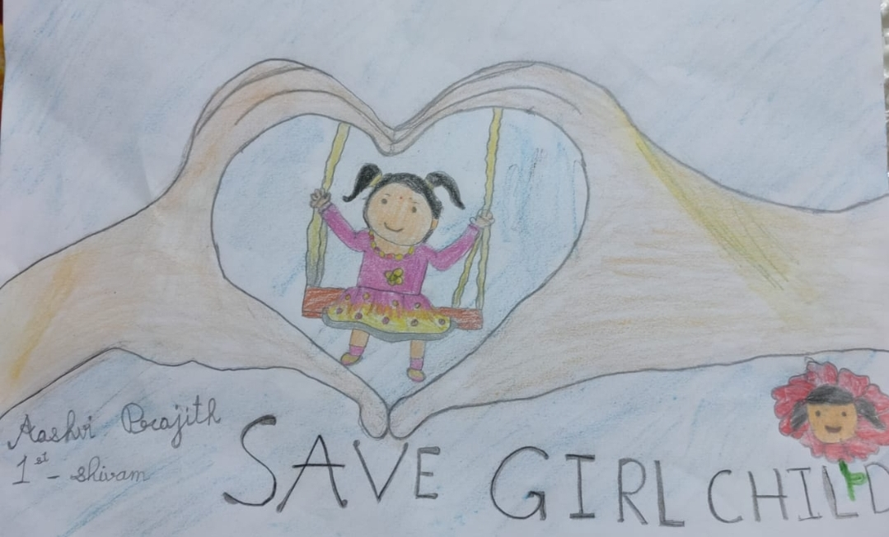
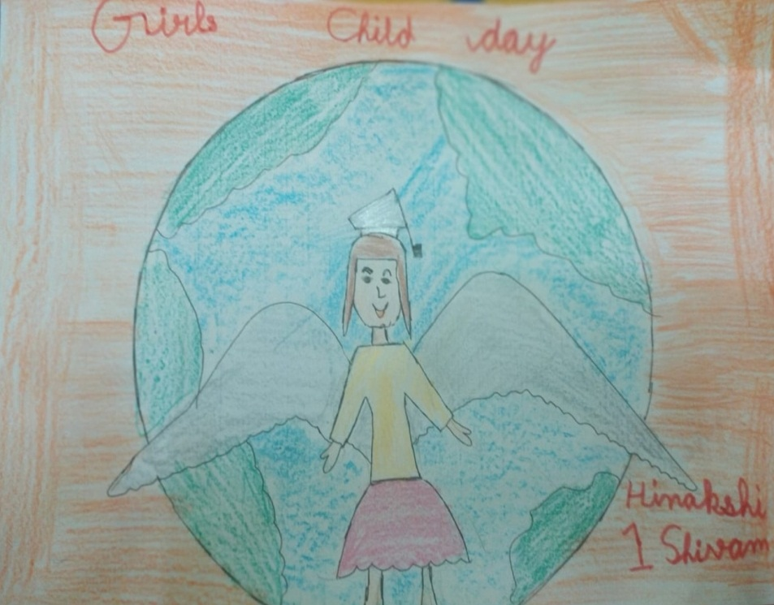
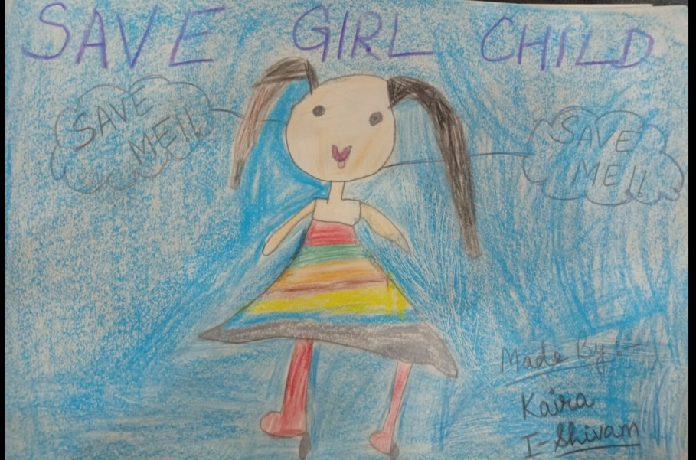
Save Girls Posters
Aashvi Prajith
Navya Garg
Hinakshi
Kaira

Slide 7
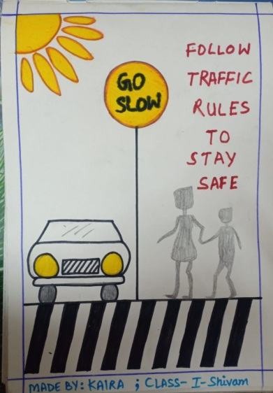
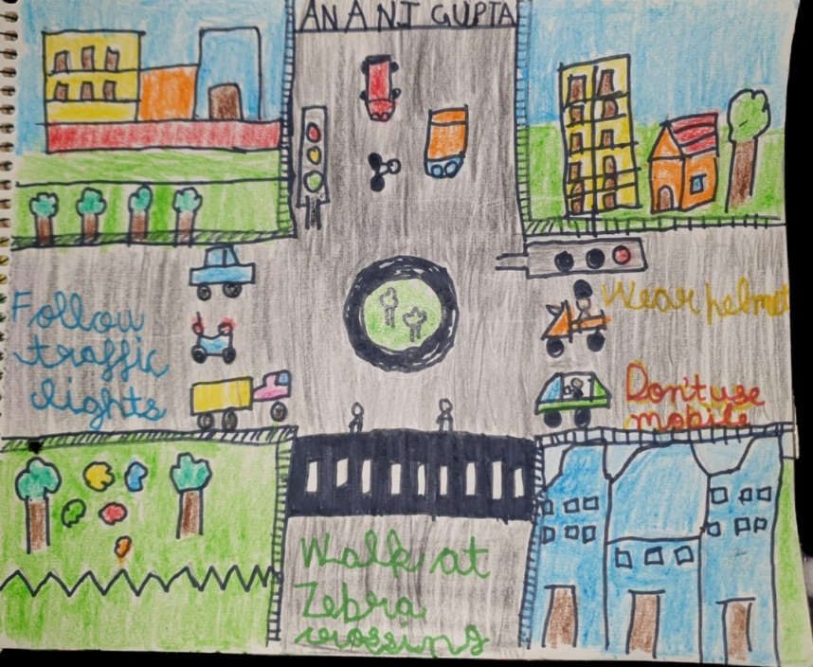
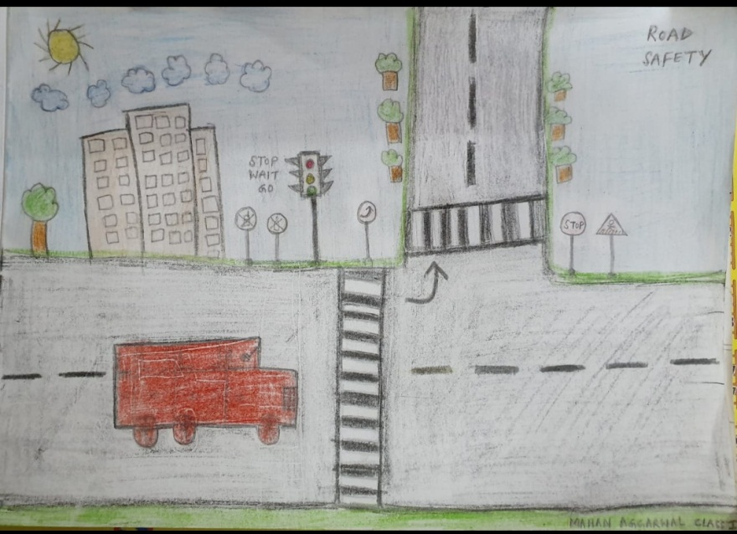

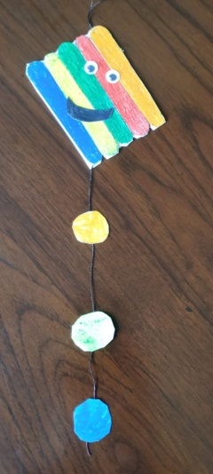
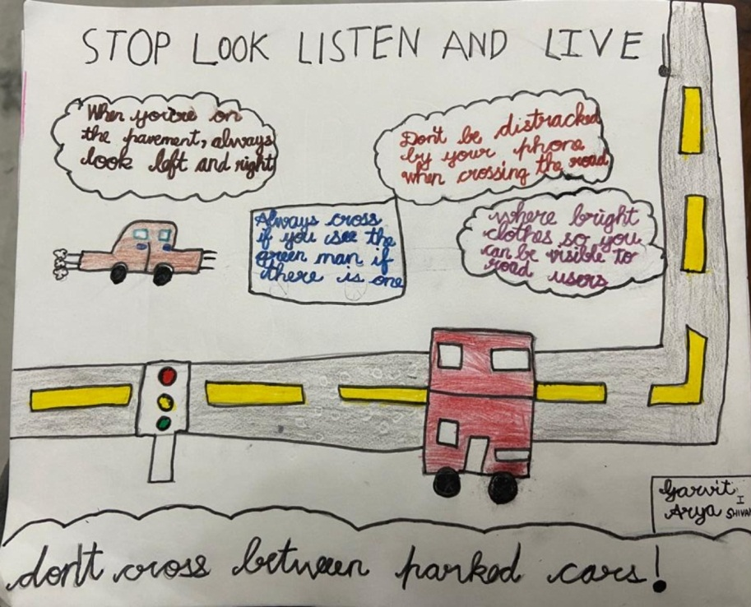
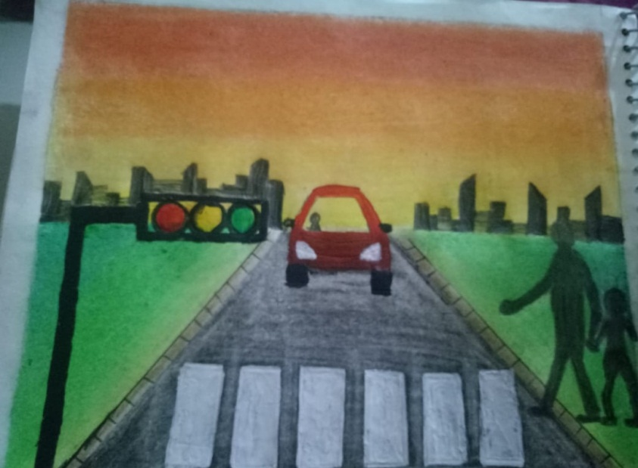
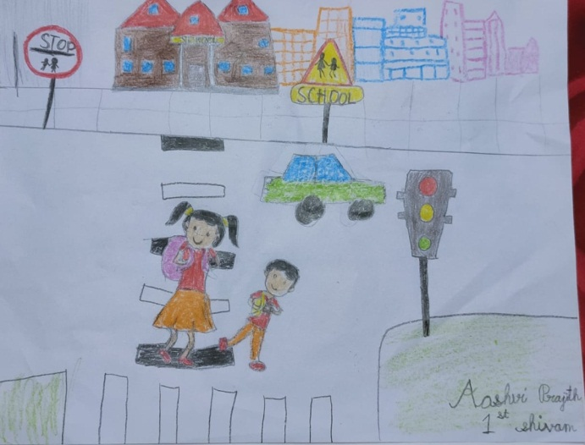
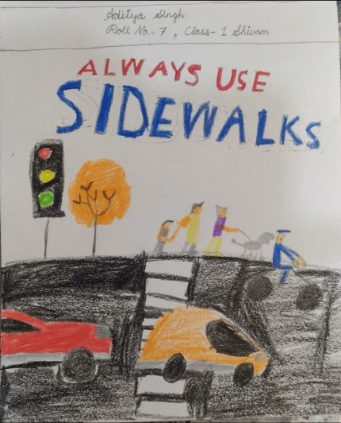
Road Safety Posters

Slide 8

Year is Ending not the Enthusiasm
Sundaram 1
Class Teacher -Mrs.Sonia Sood

Slide 9

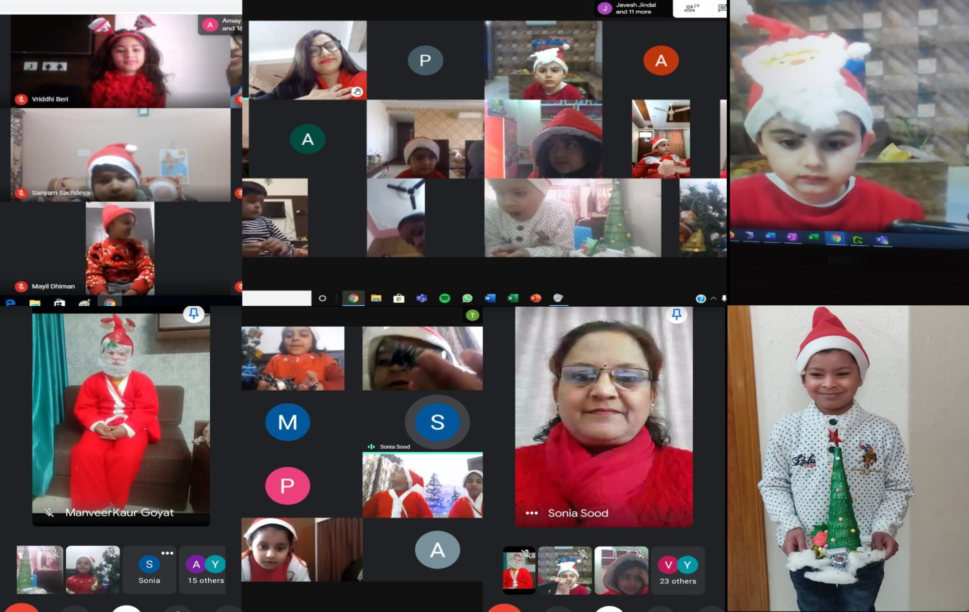
Kids Favourite ‘SANTA TIME !!!’

Slide 10

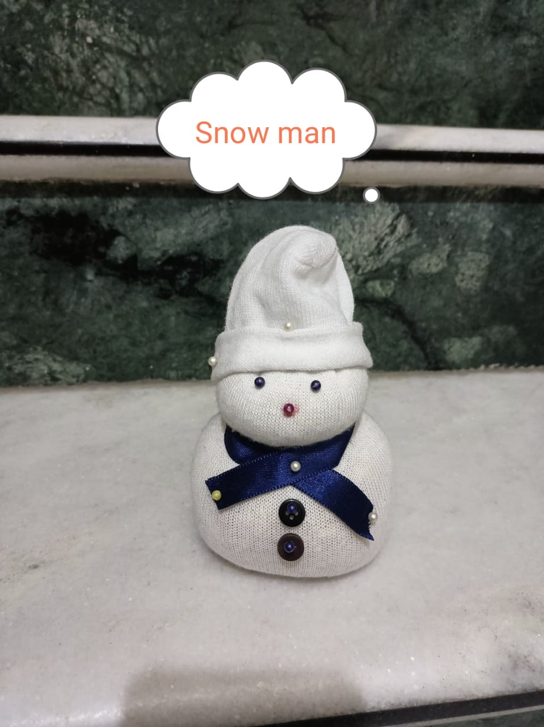
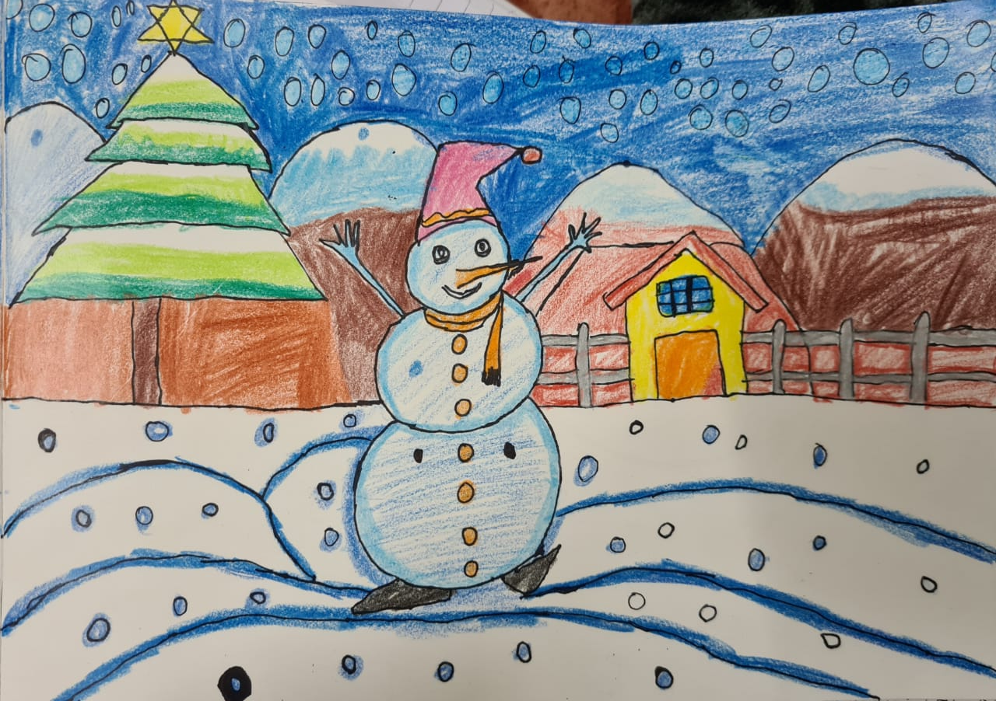
CUTE
SNOW MAN BY DRISHTI
AMAY JINDAL’S DANCING SNOW MAN ☺

Slide 11

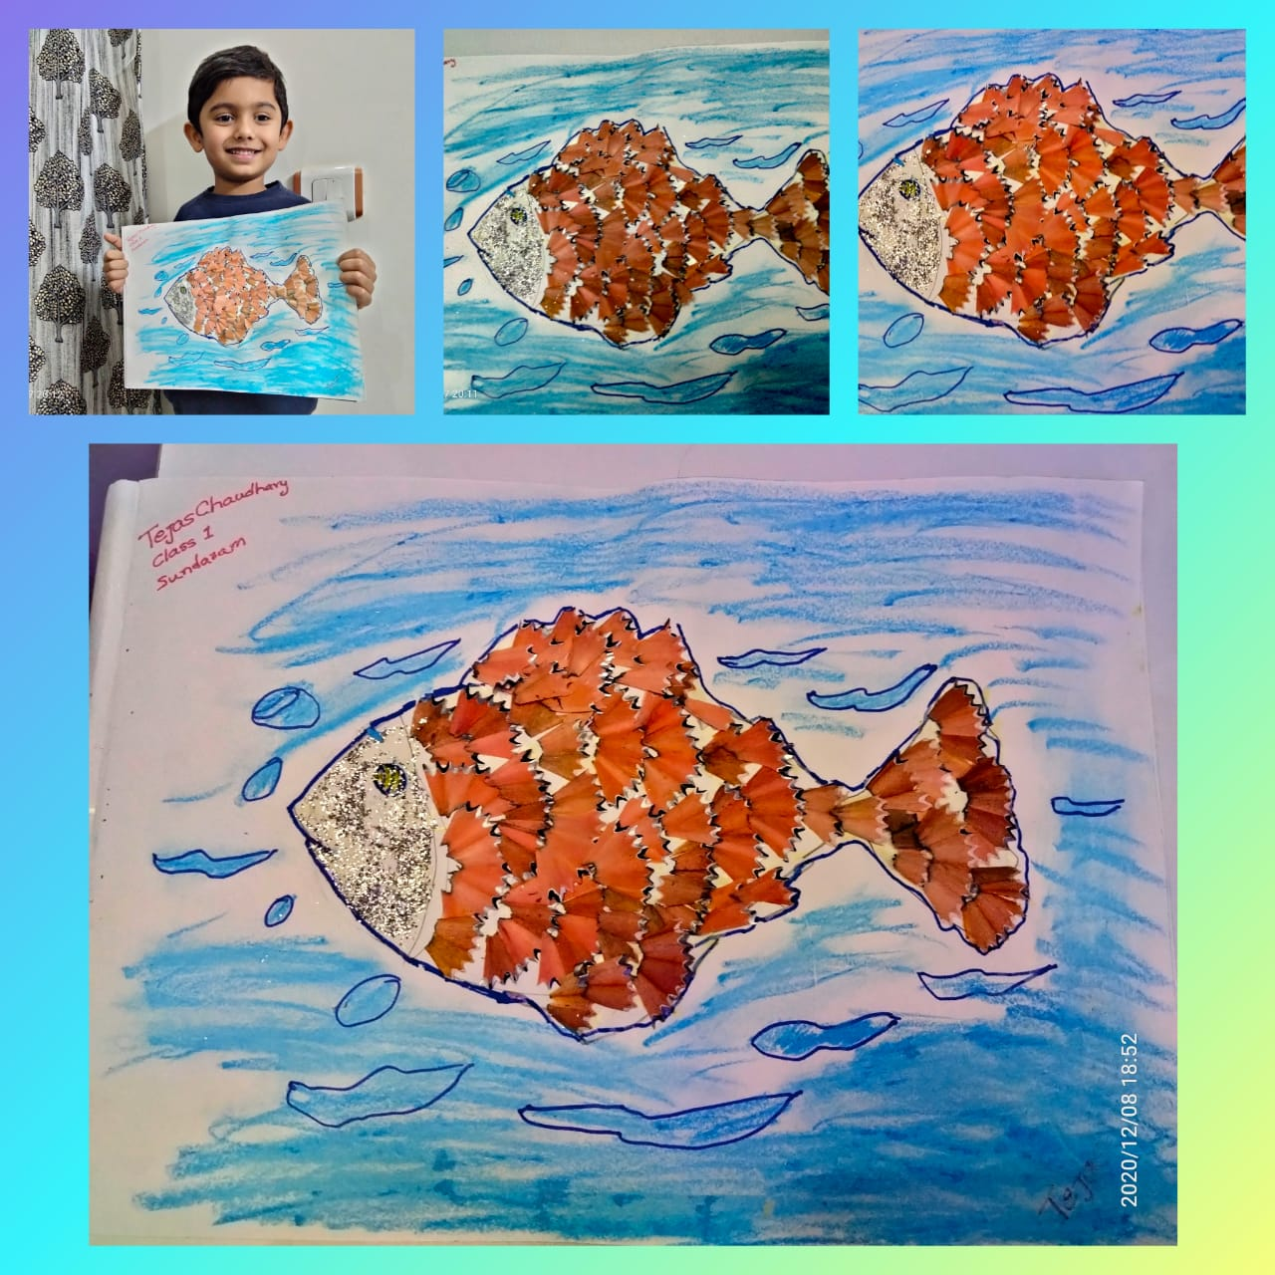
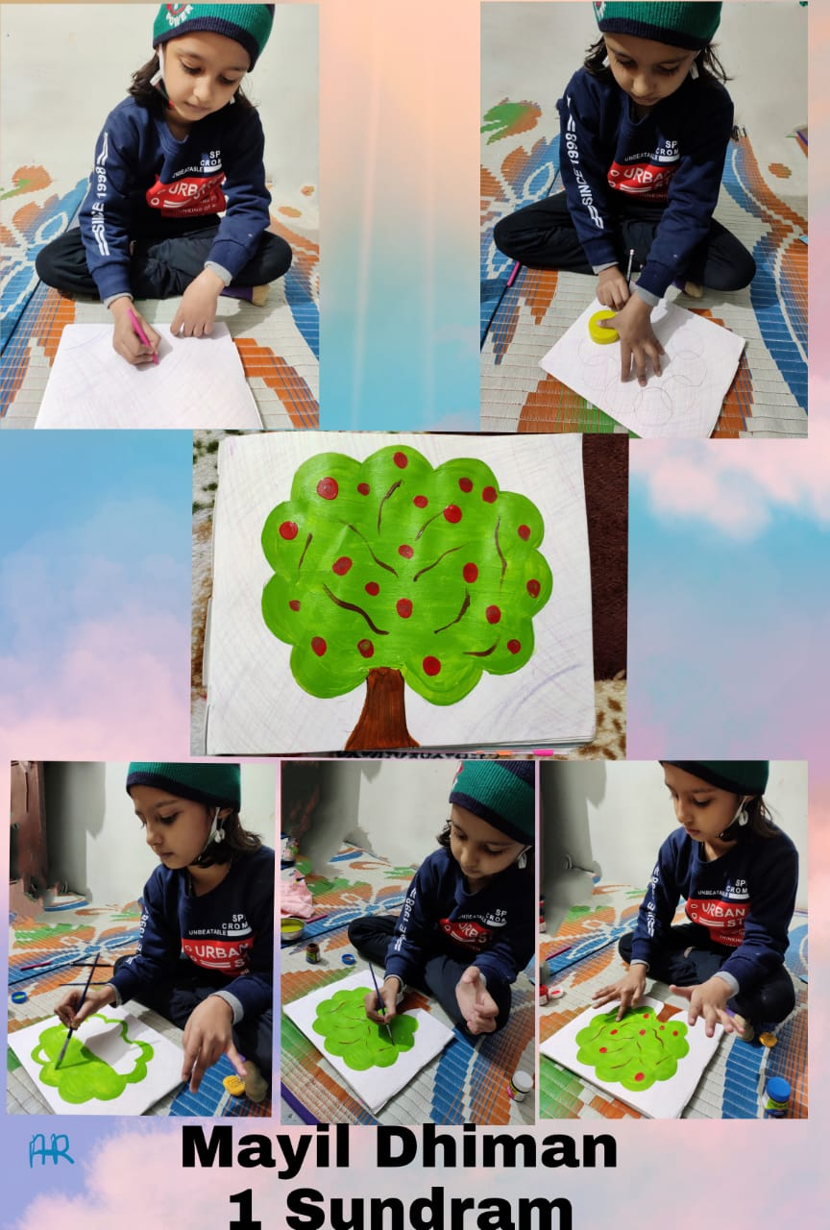
Little Artist
Tejas Chaudhary

Slide 12

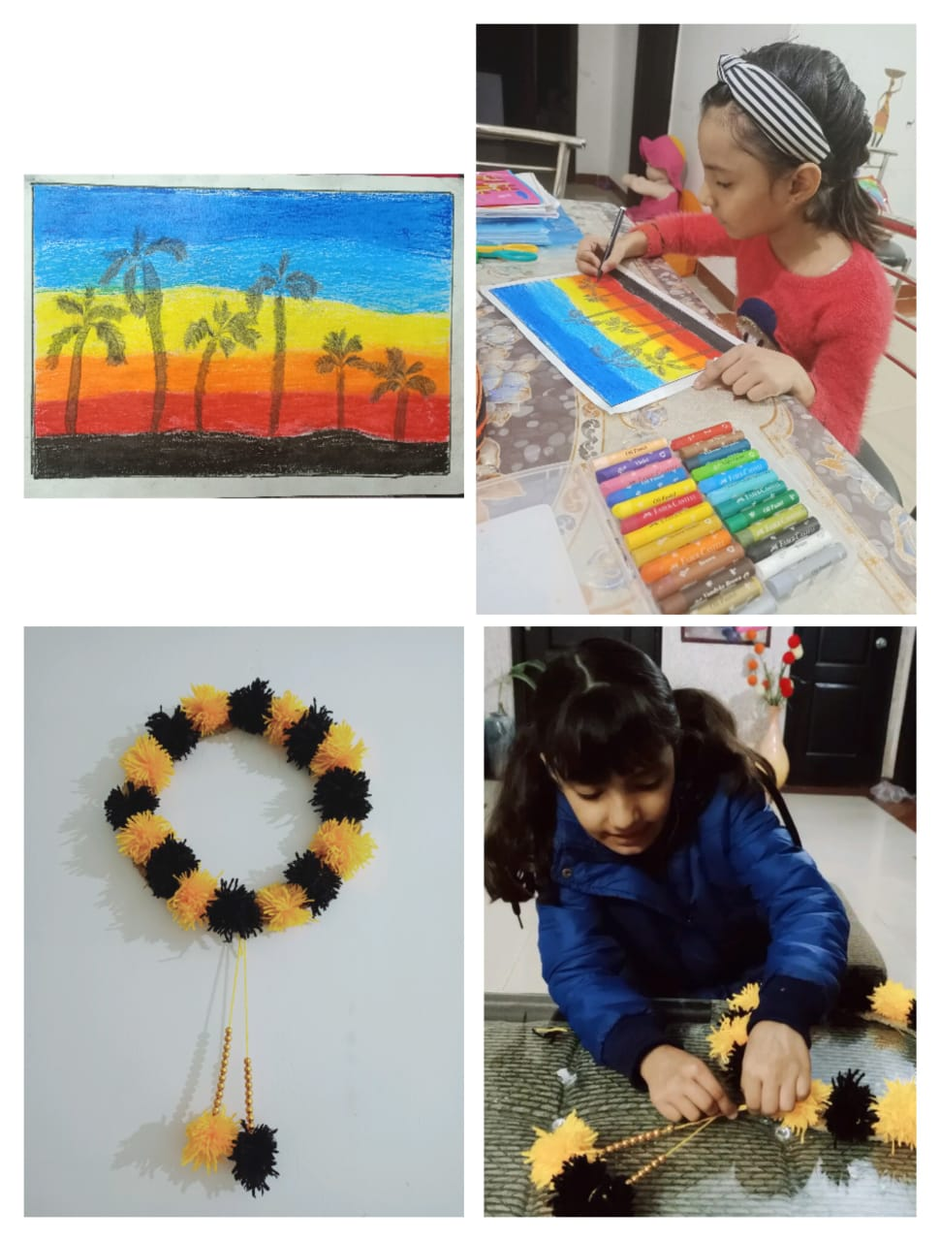
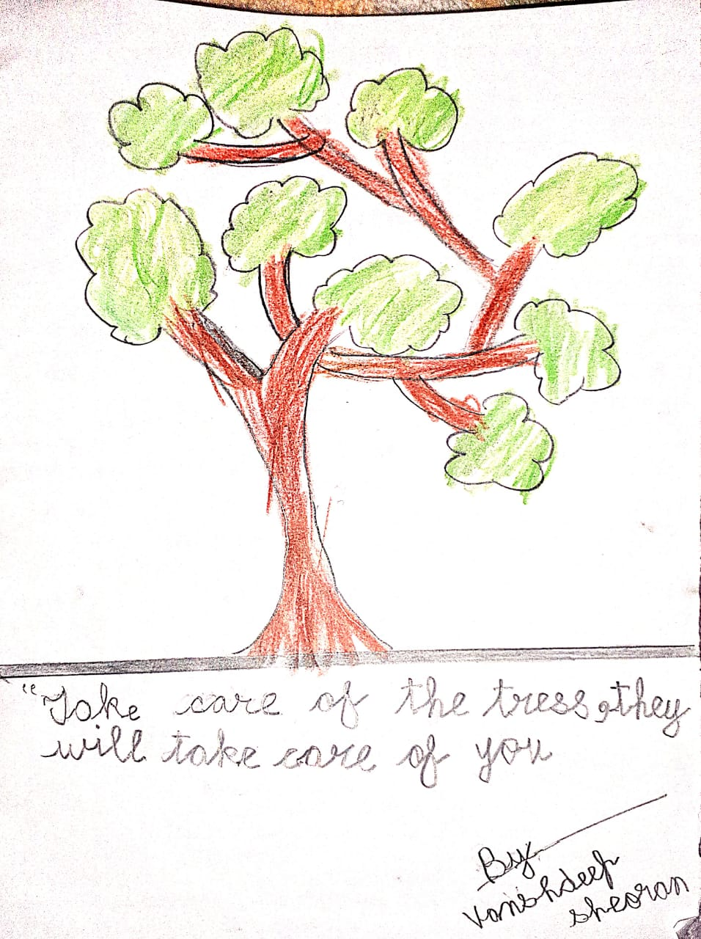
There is no age of learning .. New skill by Jill Soni
Our Nature should be protected!
(Vanshdeep)

Slide 13

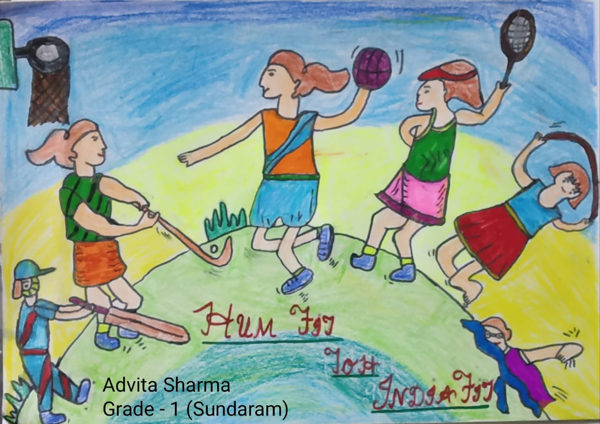
Fit India initiative by the school
https://youtu.be/78yyypj0rkc
Meet the skater of Sundaram –Sahas Nakai

Slide 14
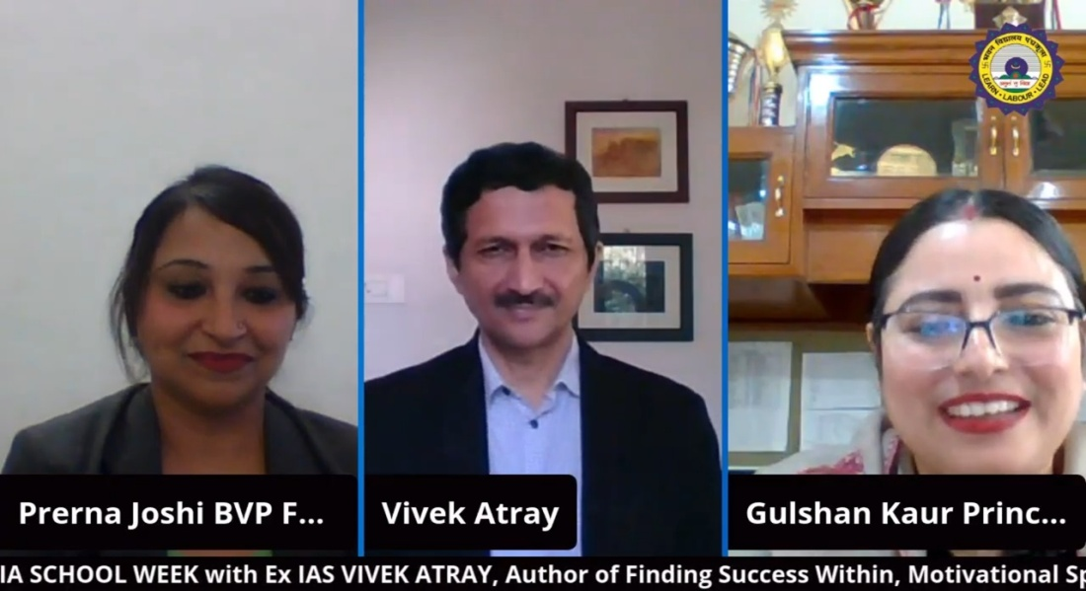
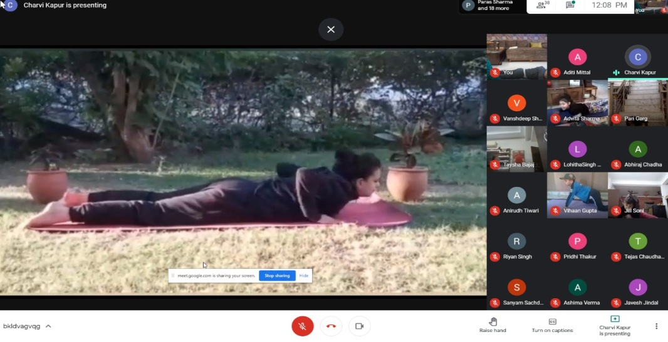
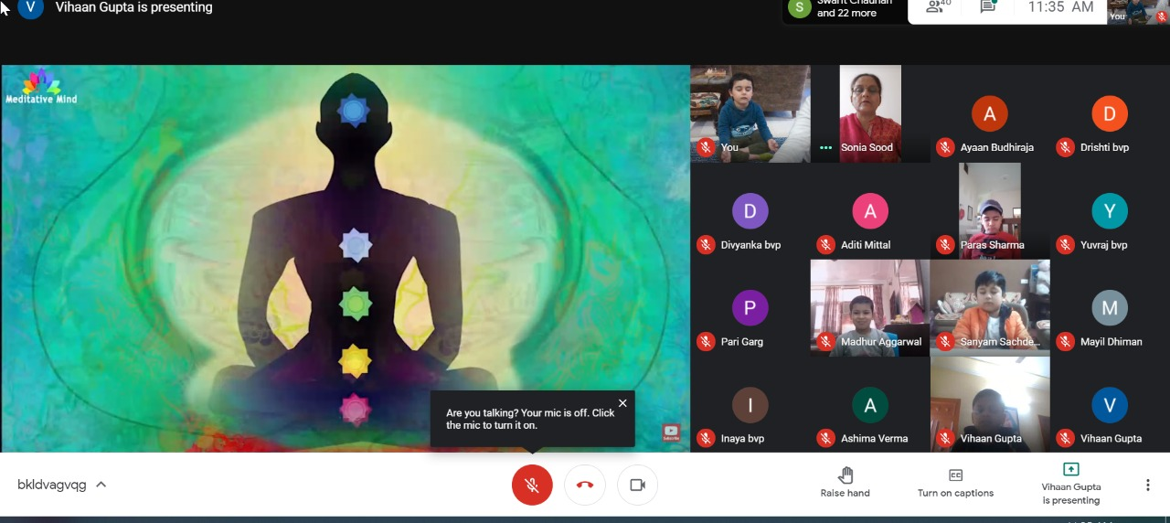

Slide 15

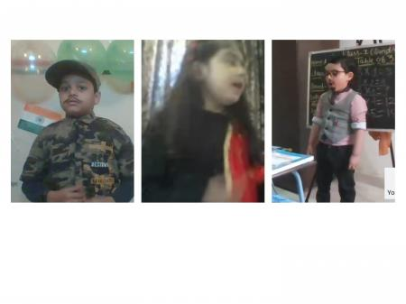
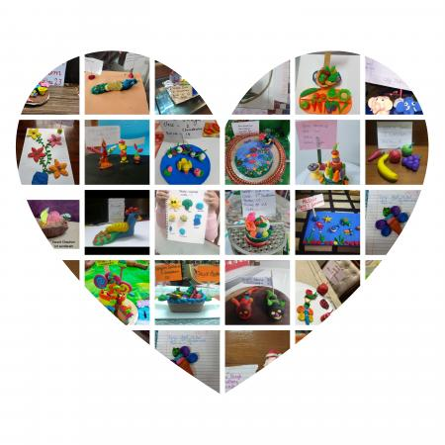
Parelika Competiton Clay modelling and Sabse bade Dramebaaz
Vihaan – Taysha – Adhrit

Slide 16
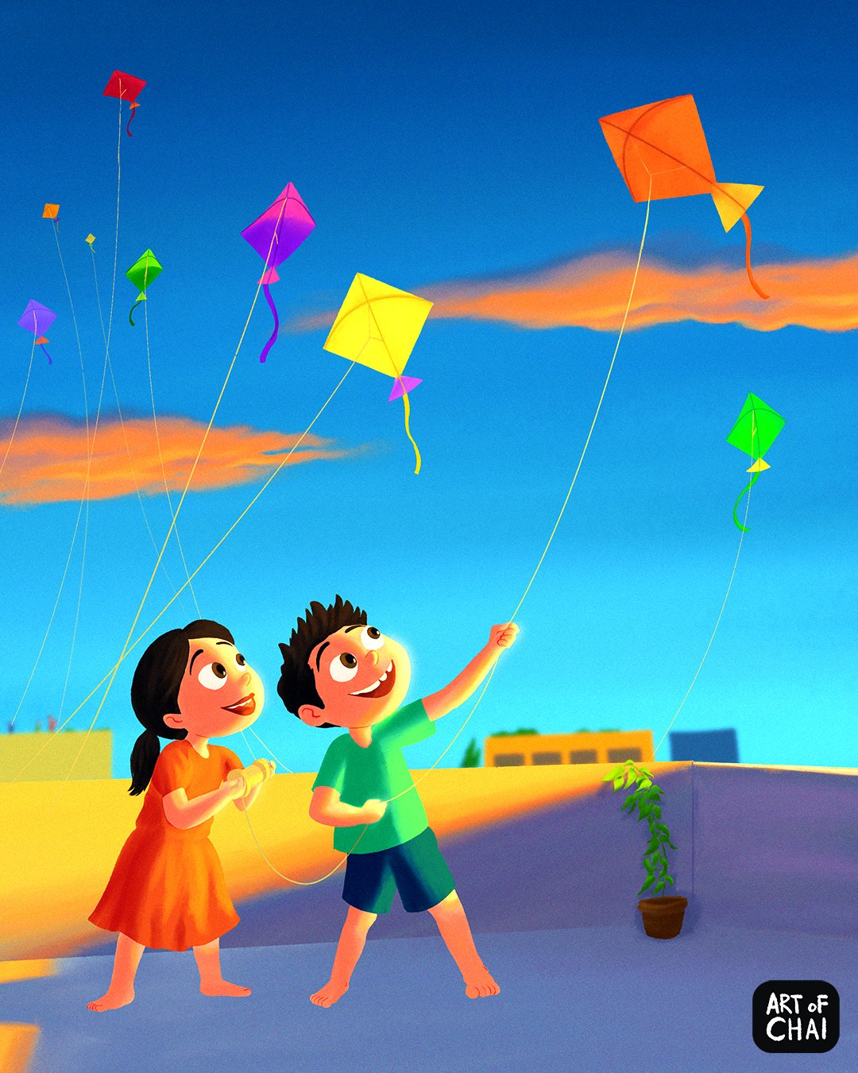
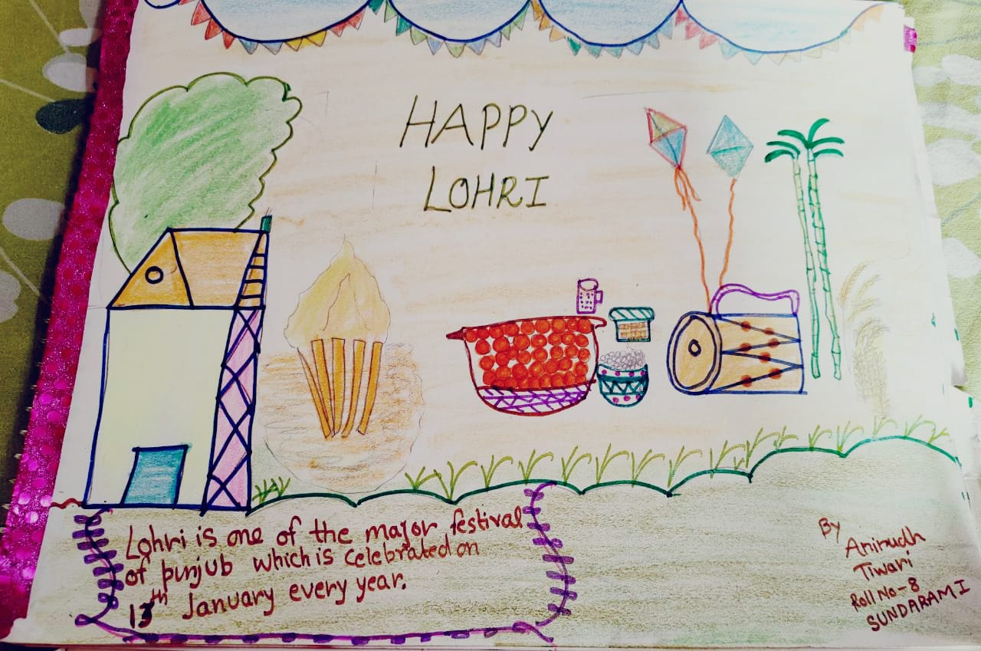
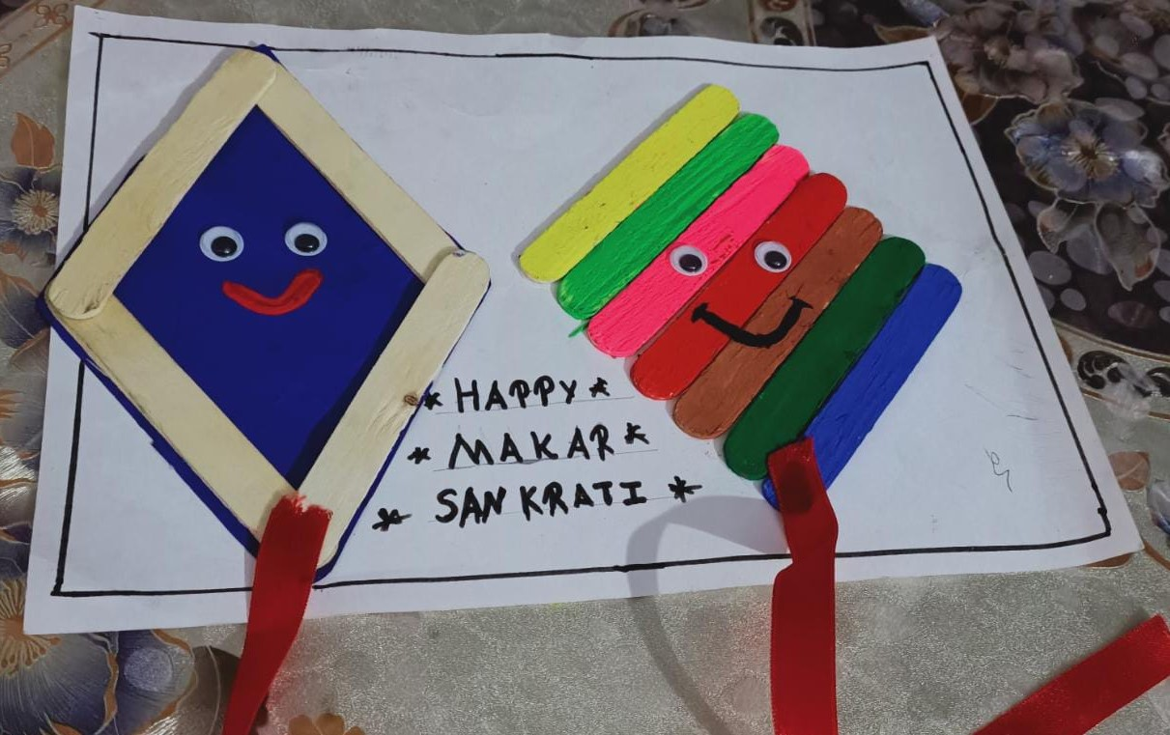

LETS CELEBRATE LOHRI AND MAKAR SANKRANTI
Lohri art by- Anirudh Tiwari
KITES BY JILL SONI

Slide 17

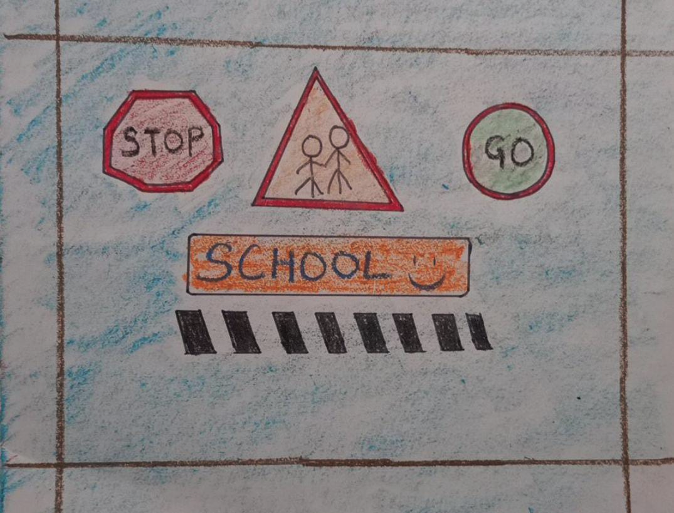
Safety rules by Aditi Mittal

Slide 18

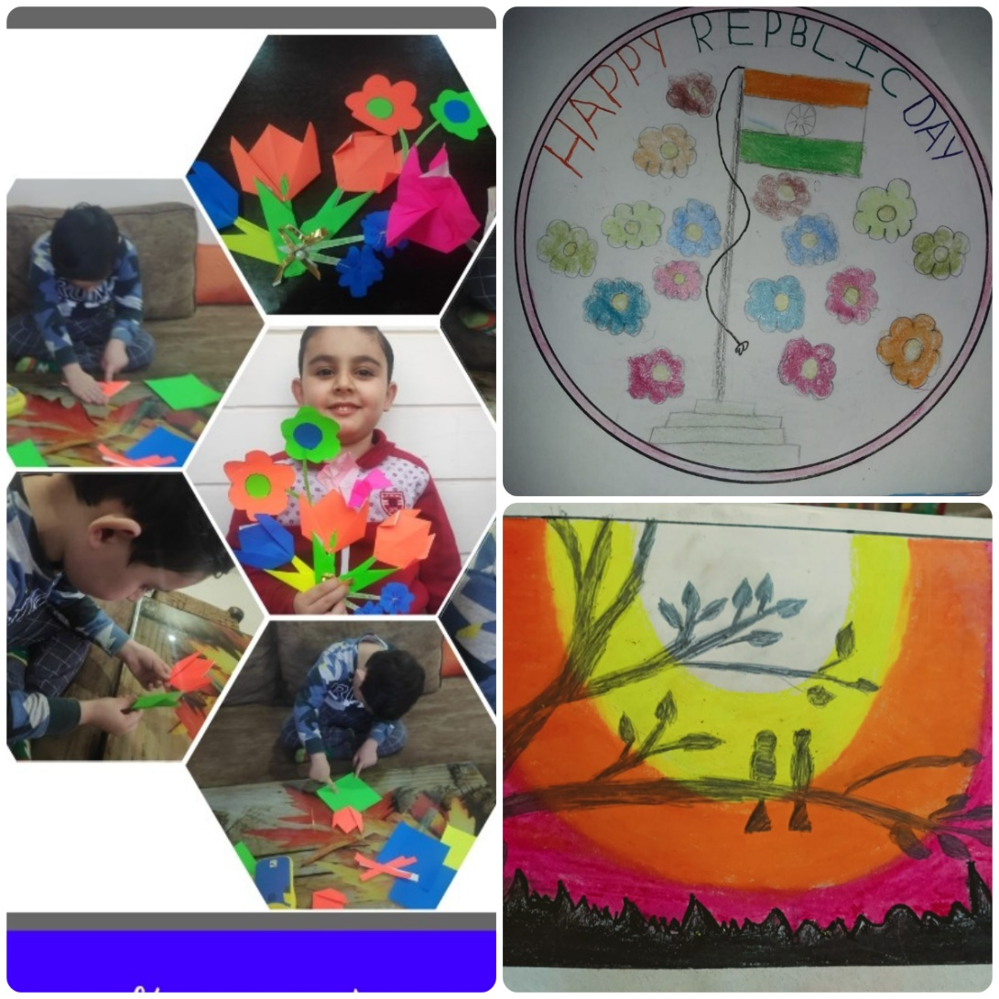
Paper flower Art by Adhirt Arora
Repulic Day drawing by – Mayil Dhiman
Scenary by Jill Soni

Slide 19

Class 1 Shubham
Month – December
Class Teacher – Ms. Shipra Gupta

Slide 20

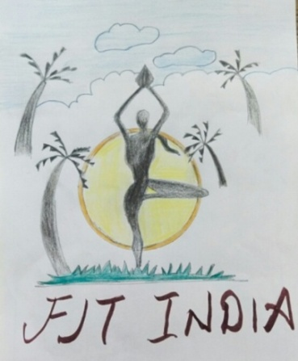
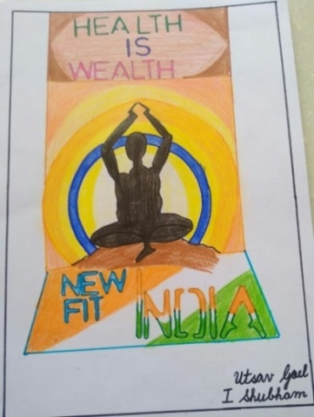
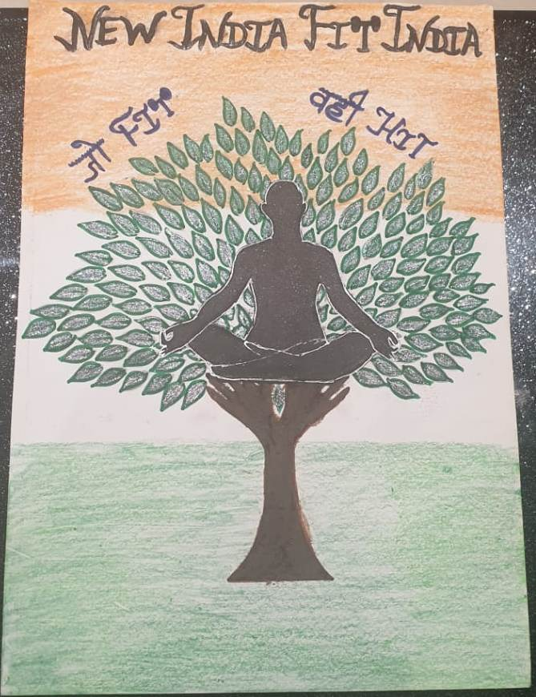
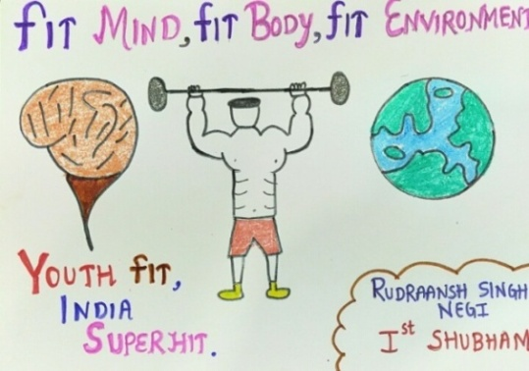

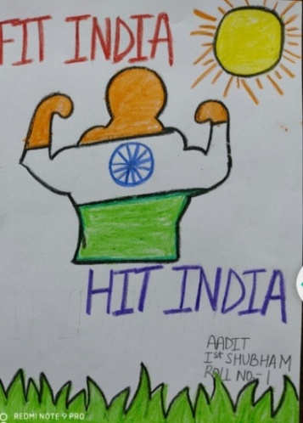

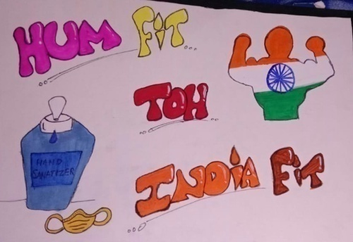

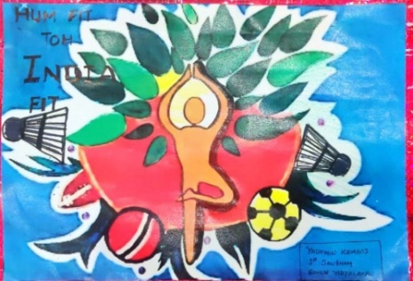
Rudraansh
Maahir
Utsav
Aarush Jain
Prabhleen
Aadit
Yashwin
Aarush Bansal
Yoga opens both mind and soul

Slide 21


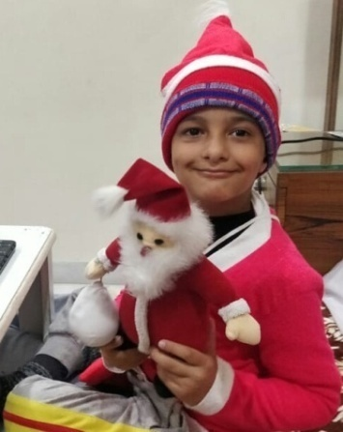







Slide 22













Creativity at its Summit
Viraaj
Aarush Jain
Purvanshi
Aarush Jain
Jeana
Aarohi
Reyansh

Slide 23



Little Youtubers
Avanya as Laxmi Bai
https://youtu.be/AEnzcyIMhs4
Viraaj as Milkman
https://youtu.be/2k7Eamy5ElY
Bhavneet as Sunny Deol
https://youtu.be/8uvht2Uwfh8

Slide 24

Artists of
Class l Sangam
Class teacher- Ms. Kavita Ranyal

Slide 25








Yatin Goyal
Akhil Jain
Prachi
Tushani Sabharwal
Kevin Rao
Anica Kaul
Tanvi Singla
Neeti Goyal

Slide 26





Craft Corner
Taanish Goel’s
leaf pasting
Kavyan Singla’s vegetable craft
Yakshi’s CD craft
Ayaan Sharma’s snowman
Yuvant Mor’s CD craft

Slide 27












Slide 28













https://youtu.be/yFedwLfGzPA
Anica Kaul
https://youtu.be/MQJfffy9gF8
Parth Sharma
https://youtu.be/9BSOmRp8J24
Yuvant Mor
https://youtu.be/ZV4jOnbVWHM
Aaradhya Sharma

Slide 29




Our Videos
https://youtu.be/6eICqNYfdpo
Sehaj
https://youtu.be/-EPr0P-mnwg
Mayra Sharma
https://youtu.be/ENVzt-jsY_E
Aaradhya Sharma
https://drive.google.com/file/d/1GQ9lzPCtAqPtimeHnj3FjllEWXiXORkI/view?usp=drivesdk
Raghav
Sandhya
Advik Gupta
Aanya Gupta

Slide 30









Our drawings
Shanaya
Harshiv Singla
NeetiGoyal
Chitraaksh
Vihaan Taangri
Ashank Gauba
Mayra Sharma
Avni

Slide 31








Republic Day & Lohri Fervour
https://youtu.be/Pw_CANWBhtE
Sabse aage honge hindustani by Raghav Gauttam
Yatin
Kavyan
Prachi
Yuvant
Shanaya

